Slide 1


Log File Analysis & Reporting System
By: Omkar Navpute
Notes:
1

Slide 2
Project Introduction
The Log File Analysis & Reporting System is a Python-based command-line application designed to analyze and generate reports from Apache-style web server log files. This tool parses log entries, normalizes user-agent data (like OS, browser, and device), and stores the valid entries in a MySQL database. Using SQL queries, it then produces insightful reports on web traffic, error rates, and user behavior trends.
Notes:
2

Slide 3




Key Objectives
Efficient Parsing
Data Normalization & Storage
Parse and validate large web server log files with high efficiency and accuracy.
Normalize and store structured log data in a relational MySQL database for optimal retrieval.
Meaningful Reporting
Extensible Functionality
Provide insightful reports on server traffic, error rates, and user behavior trends.
Design an extensible architecture to easily add more advanced analytics features in the future.
Notes:
3

Slide 4





System Methodology & Technology Stack
Layered Methodology
Technology Stack
Programming Language: Python 3.10+
Parsing Layer
Database: MySQL
Utilizes regular expressions for precise field extraction from raw log lines.
Key Libraries & Modules:
argparse: For robust command-line interface interaction.
mysql-connector-python: Seamless integration with MySQL databases.
Database Layer
tabulate: Generates formatted and readable console output for reports.
Manages data storage and normalized relationships within MySQL.
configparser: Facilitates secure loading of database configurations.
Normalization
Decomposes user agent strings into OS, browser, and device for detailed analysis.
Reporting Layer
Employs SQL queries to generate analytical results and insights.
CLI Interface
Leverages argparse for defining commands and flags for report generation.
Notes:
4

Slide 5
Project Flow: From Log to Report
1. Log File Input
Apache-style .log files are provided as input via the command-line interface.
2. Parsing
The LogParser extracts critical fields like IP, timestamp, method, path, status code, and user agent.
3. Normalization
User agent strings are parsed and stored separately to ensure data consistency and reduce redundancy.
4. Database Storage
Validated log entries are securely inserted into the log_entries table in the MySQL database.
5. Report Generation
SQL-based queries are executed via the CLI to generate various analytical reports, displayed in tabular format.
Notes:
5

Slide 6
Core Features
Log Parsing
User Agent Normalization
MySQL Integration
Accurately parses Apache Common Log Format, handling diverse log entry structures.
Extracts and normalizes user agent data, providing insights into client OS, browser, and device.
Efficiently stores and retrieves log records using a robust MySQL database backend.
CLI Report Generation
Extensible Architecture
Supports command-line interface-based report generation with clear, tabular output.
Designed with a modular architecture that allows for easy addition of new reports and features.
Notes:
6

Slide 7
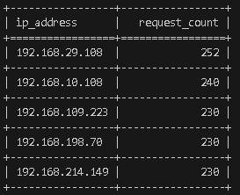
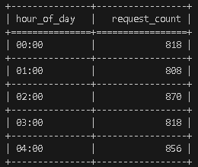
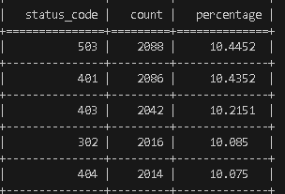
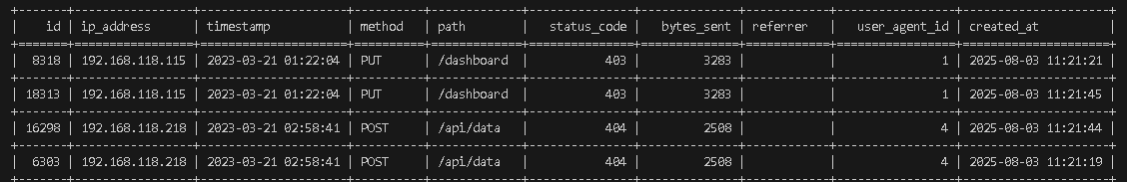
Results
Notes:
7

Slide 8

Conclusion & Future Directions
The Log File Analysis & Reporting System effectively transforms raw server logs into structured, insightful analytics using Python and MySQL. Its modular design ensures accurate parsing, normalization, and storage. The CLI offers flexible reporting, assisting administrators in monitoring traffic and understanding user behavior. This project lays a strong foundation for future enhancements such as visualization dashboards, exportable reports, and integration with other monitoring tools, making it well-suited for real-world server environments.
Notes:
8

